Slide 1
MySQL Data Types
The data type of a column defines what value the column can hold: integer, character, money, date and time, binary, and so on.
Each column in a database table is required to have a name and a data type.
We must decide what type of data that will be stored inside each column when creating a table.
The data type is a guideline for SQL to understand what type of data is expected inside of each column, and it also identifies how SQL will interact with the stored data.
In MySQL there are three main data types: string, numeric, and date and time

Slide 2
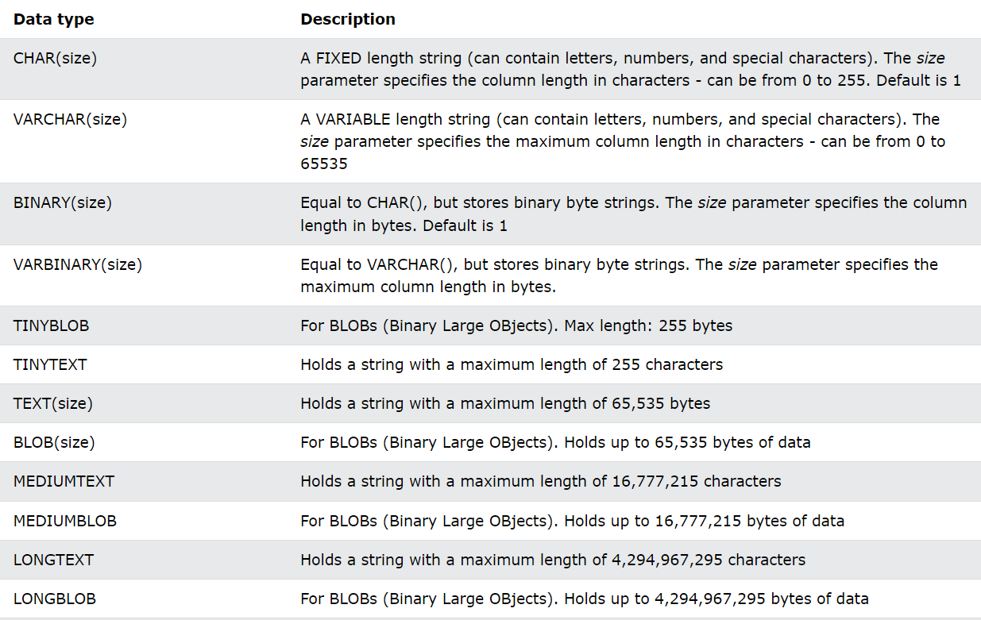
String Data Types

Slide 3
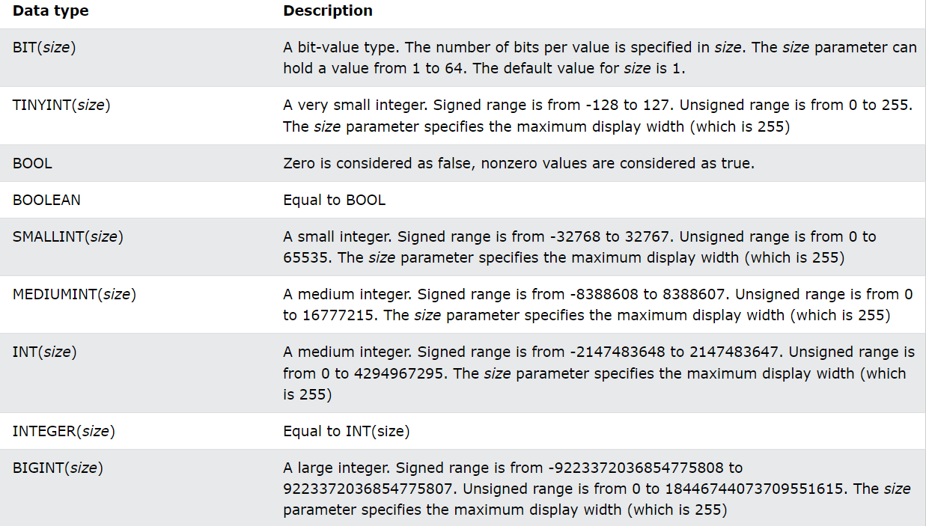
Numeric Data Types

Slide 4
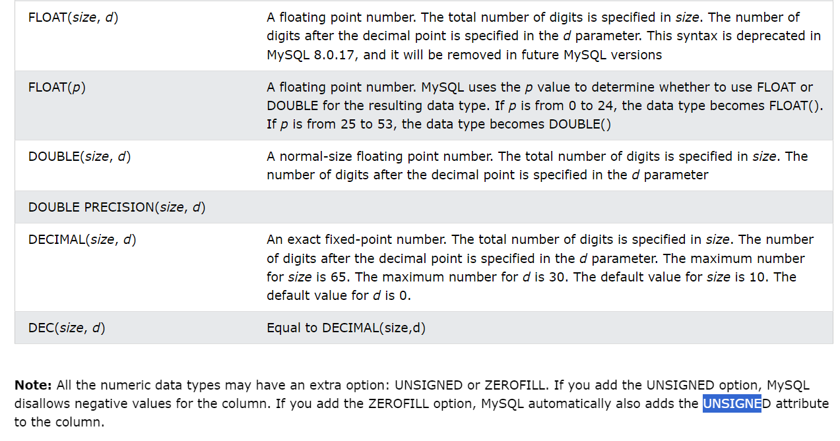

Slide 5
